Slide 1
Inception V2
Group Members
Abdul Ahad Shaikh (20K-0319)
M. Basil Ali Khan (20K-0477)
Syed Ali Jodat Naqvi (20K-0155)
CNN ARCHITECTURE

Slide 2

Contents
Background Inception V1
Challenges Addressed in Inception V2
Architectural Changes
Architecture
Architecture Details
Publication Details
Description of Key Components
Advantages and Disadvantages

Slide 3
Publication Details
Title
Rethinking the Inception Architecture for Computer Vision
Authors
Christian Szegedy
Affiliations:
Google Inc. (Szegedy, Vanhoucke, Ioffe, Shlens)
Vincent Vanhoucke
Sergey Ioffe
Jonathon Shlens
Zbigniew Wojna
University College London (Wojna)
Date of Publication
December 11, 2015
ArXiv ID
1512.00567v3 [cs.CV]

Slide 4
Background-Inception V1
Inception-v1, also known as GoogLeNet, marked a significant milestone in image classification. Introduced in 2014, it achieved state-of-the-art performance at the ILSVRC competition.
Despite its success, Inception-v1 had areas for improvement, particularly concerning the use of larger convolutions like 5×5 and challenges related to information loss during dimension reduction.

Slide 5
Challenges Addressed in Inception-v2:
Information Loss and Computational Efficiency:
Inception-v2 tackled the issue of information loss by replacing the 5×5 convolution with two 3×3 convolutions. This not only enhanced accuracy but also reduced computational time.
The transition from nXn factorization to 1xn and nx1 factorization further optimized computational complexity, making the architecture more efficient.

Slide 6
Architectural Changes
Factorization Techniques:
Inception-v2 adopted factorization strategies, such as breaking down the 3×3 convolution into a sequence of 1×3 and 3×1 convolutions, achieving a 33% reduction in computational cost.
This factorization is particularly effective for input sizes ranging from 12 to 20, offering improved performance in certain scenarios.
2. Expansion of Feature Banks:
To address representational bottlenecks, Inception-v2 expanded feature banks rather than making the architecture deeper. This approach prevented the loss of valuable information, contributing to enhanced performance.

Slide 7

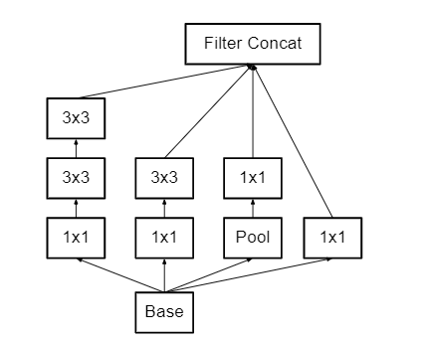
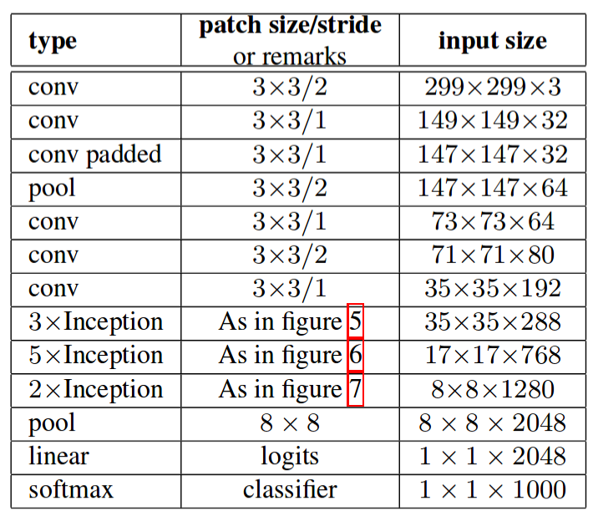
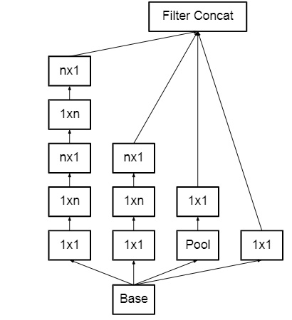
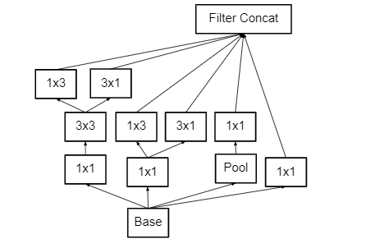
Architecture
Figure 5
Below is the layer-by-layer details of Inception V2:
Figure 6
Figure 7

Slide 8
Architectural Detailed Description
Input Layer (conv 3×3/2)
Type: Convolutional Layer
Convolutional Layer (conv 3×3/1)
Type: Convolutional Layer
Padded Convolutional Layer (conv padded 3×3/1)
Type: Convolutional Layer with zero-padding
Patch Size/Stride: 3×3 with a stride of 2
Input Size: 299×299×3 (3 color channels)
Output Size: 149×149×32
Remarks: Initial convolutional layer to process the input image.
Patch Size/Stride: 3×3 with a stride of 1
Input Size: 149×149×32
Output Size: 147×147×32
Remarks: Additional convolutional layer with a stride of 1.
Patch Size/Stride: 3×3 with a stride of 1
Input Size: 147×147×32
Output Size: 147×147×32
Remarks: Convolution with zero-padding to maintain grid size.

Slide 9
Architectural Detailed Description (Contd.)
Pooling Layer (pool 3×3/2)
Type: Max Pooling Layer
Convolutional Layer (conv 3×3/1)
Type: Convolutional Layer
Patch Size/Stride: 3×3 with a stride of 2
Input Size: 147×147×32
Output Size: 73×73×64
Remarks: Down-sampling the feature map through max pooling.
Patch Size/Stride: 3×3 with a stride of 1
Input Size: 73×73×64
Output Size: 71×71×80
Remarks: Further convolutional processing.
Inception Module (3×Inception):
Type: Inception Module with three inception blocks
Input Size: 35×35×192
Output Size: 35×35×288
Remarks: Utilizing the inception module with various filter banks to extract complex features.

Slide 10
Architectural Detailed Description (Contd.)
Inception Module (5×Inception):
Type: Inception Module with five inception blocks
Input Size: 17×17×768
Output Size: 17×17×768
Remarks: Utilizing the inception module for deeper processing and feature extraction.
Inception Module (2×Inception):
Type: Inception Module with two inception blocks
Input Size: 8×8×1280
Output Size: 8×8×2048
Remarks: Further inception processing at the coarsest level.
Global Average Pooling Layer (pool 8×8):
Type: Global Average Pooling Layer
Input Size: 8×8×2048
Output Size: 1×1×2048
Remarks: Pooling to reduce spatial dimensions to a global level.

Slide 11
Architectural Detailed Description (Contd.)
Linear Layer (linear logits):
Type: Fully Connected Linear Layer
Input Size: 1×1×2048
Output Size: 1×1×2048
Remarks: Linear layer for generating logits.
Softmax Classifier (softmax classifier):
Type: Softmax Layer
Input Size: 1×1×2048
Output Size: 1×1×1000
Remarks: Final layer for classifying input into 1000 categories (ImageNet classes).

Slide 12
Description of Key Components
Stem Network:
The architecture begins with a stem network that processes the input image. It involves a series of convolutional and pooling layers to extract basic features and reduce the spatial dimensions of the input.
Inception Modules:
Inception-v2 utilizes a series of inception modules throughout the network. These modules are characterized by their parallel paths of convolutions with different kernel sizes, enabling the network to capture features at multiple scales simultaneously. The inception modules incorporate factorization techniques, breaking down larger convolutions into smaller, more computationally efficient operations.
Factorization Techniques:
Inception-v2 employs factorization strategies, such as breaking down 3×3 convolutions into a sequence of 1×3 and 3×1 convolutions. This reduces the computational complexity while maintaining the receptive field, making the architecture more efficient.
Grid Reduction Techniques:
To control the growth of computational cost, grid reduction techniques are applied at certain points in the architecture. These involve pooling layers or convolutions with strides to decrease the spatial dimensions of the feature maps, reducing the grid size between inception blocks.

Slide 13
Description of Key Components (Contd.)
Feature Banks Expansion:
Instead of increasing the depth of the architecture to avoid representational bottlenecks, Inception-v2 opts for expanding the feature banks within the inception modules. This strategy helps prevent the loss of valuable information and contributes to more balanced feature extraction.
Auxiliary Classifiers:
Inception-v2 incorporates auxiliary classifiers at intermediate stages of the network during training. Although introduced to mitigate the vanishing gradient problem and enhance convergence, the effectiveness of these auxiliary classifiers is discussed, and Inception-v2 authors found limited improvement during early training stages.
Final Pooling and Classification Layers:
The architecture concludes with global average pooling to reduce the spatial dimensions to 1×1, followed by fully connected layers for classification. The final layer produces the network's predictions, typically with a softmax activation function for multi-class classification.

Slide 14
Advantages
Addressed information loss with 3×3 convolutions.
Reduced computational time with factorization.
Factorization strategies adapt to various sizes.
Expanded feature banks prevent representational bottlenecks.
Stable performance observed with adherence to fundamental principles.
Disadvantages
A complex architecture, making it challenging to interpret and implement for some applications.
Demands significant computational resources, making it resource-intensive.
Requires substantial computational resources, limiting its deployment on resource-constrained devices.
The deep and intricate nature of Inception-v2 can make it challenging to interpret and explain, hindering its transparency.
Achieving optimal results with Inception-v2 often relies on large and diverse datasets, limiting its effectiveness in scenarios with limited data.

Slide 15
Thank You!

